Slide 1

L ps
-Vikas Pawar.

Slide 2
What is Loop.
loop is a control structure that allows you to execute a block of code multiple times.
Loops are used to perform repetitive tasks and are an essential part of programming.
They help you avoid writing the same code over and over again, making your programs more efficient and concise.

Slide 3
Terms used in Loops.
It consists of four parts:
Initialization: It is the initial condition which is executed once when the loop starts. Here, we can initialize the variable, or we can use an already initialized variable. [ int i = 0; ]
Condition: It is the second condition which is executed each time to test the condition of the loop. It continues execution until the condition is false. It must return boolean value either true or false. [ i<=10; ]
Updation (Incre/Decre): It increments or decrements the variable value. [ i++; or i+=5; ]
Statement: The statement of the loop is executed each time until the second condition is false.

Slide 4
Types of Loops.
For Loop
While Loops
Do-While Loop
For-Each Loop

Slide 5
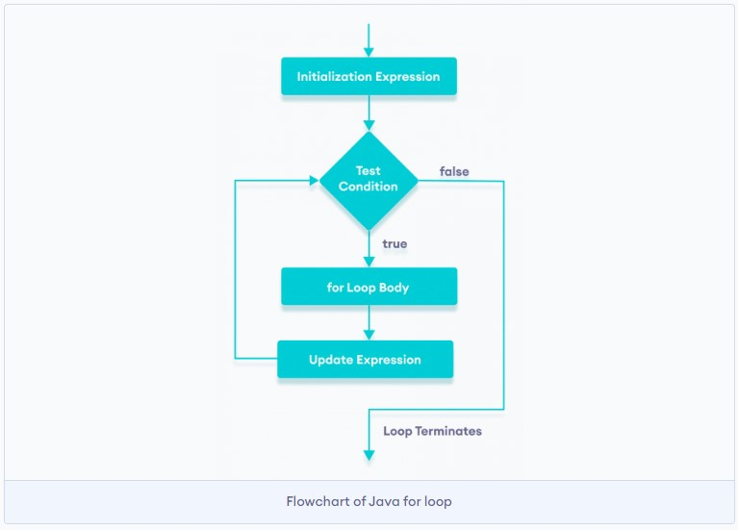
1. For Loop
A for loop is used when you know in advance how many times you want to repeat a set of instructions. It consists of three parts: initialization, condition, and iteration. The loop continues to execute as long as the condition is true.
Syntax:
for (initialization; condition; updation) {
// Code to be executed repeatedly
}

Slide 6
For Loop Program
// Java program to write a code in for loop from 1 to 10
public class Loops {
public static void main(String[] args) {
for (int i = 1; i <= 10; i++) {
System.out.println(i);
}
}
}

Slide 7
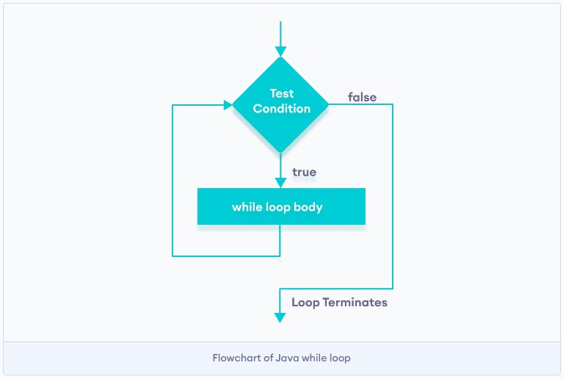
2. While Loop
A while loop is used when you want to execute a block of code as long as a certain condition is true. The condition is checked before each updation, and the loop continues until the condition becomes false.
Syntax:
initialization;
while (condition) {
// Code to be executed repeatedly
updation;
}

Slide 8
While Loop Program
// Java program to write a code in while loop from 1 to 10
public class Loops {
public static void main(String[] args) {
int i = 1;
while( i <= 10; ) {
System.out.println(i);
i++;
}
}
}

Slide 9
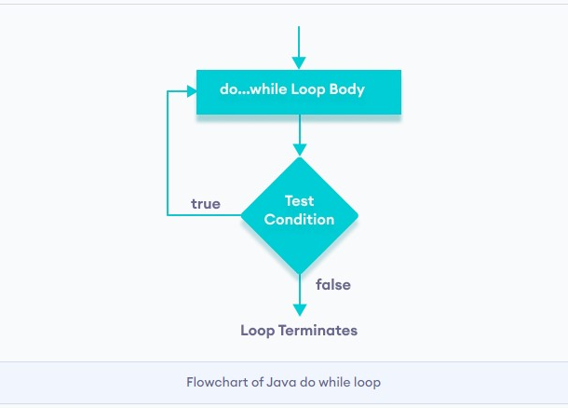
3. Do-While Loop
The do-while loop is similar to the while loop, but it guarantees that the code block is executed at least once because the condition is checked at the end of each iteration.
Syntax:
initialization;
do {
// Code to be executed repeatedly
} while (condition);

Slide 10
Do-While Loop Program
// Java program to write a code in for Do-while from 1 to 10
public class Loops {
public static void main(String[] args) {
Int i=1;
do {
System.out.println(i);
i++;
}while( i <= 10) ;
}

Slide 11
4. For-Each Loop
This loop is used to iterate through elements in an array or collection without the need for an index variable. It simplifies the process of iterating over elements.
Syntax:
data_type[ ] array_name = { Values };
for(data_type variable : array_name){
//code to be executed
}

Slide 12
For-Each Loop Program
// Java program to write a code in for-each loop from 1 to 10
public class Loops {
public static void main(String[] args) {
int[ ] arr = {1,2,3,4,5,6,7,8,9,10};
for (int num : arr) {
System.out.println(num);
}
}
}

Slide 13
Thank You.!

